Slide 1

DPWII.com
By Drew Wallace

Slide 2
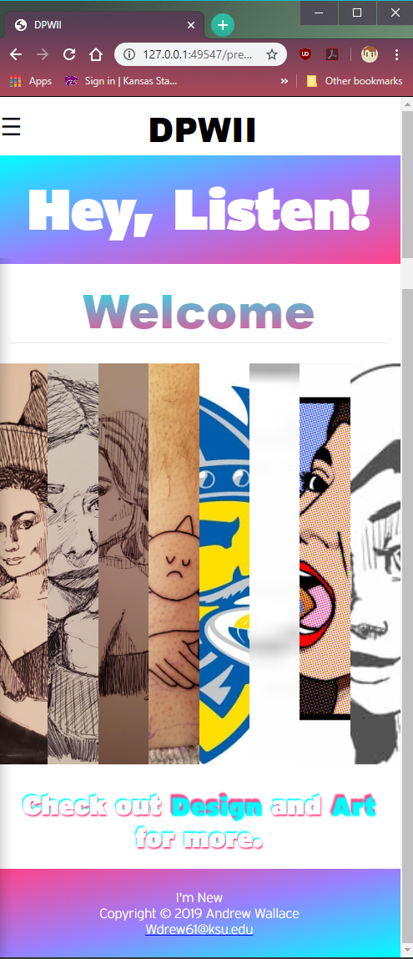
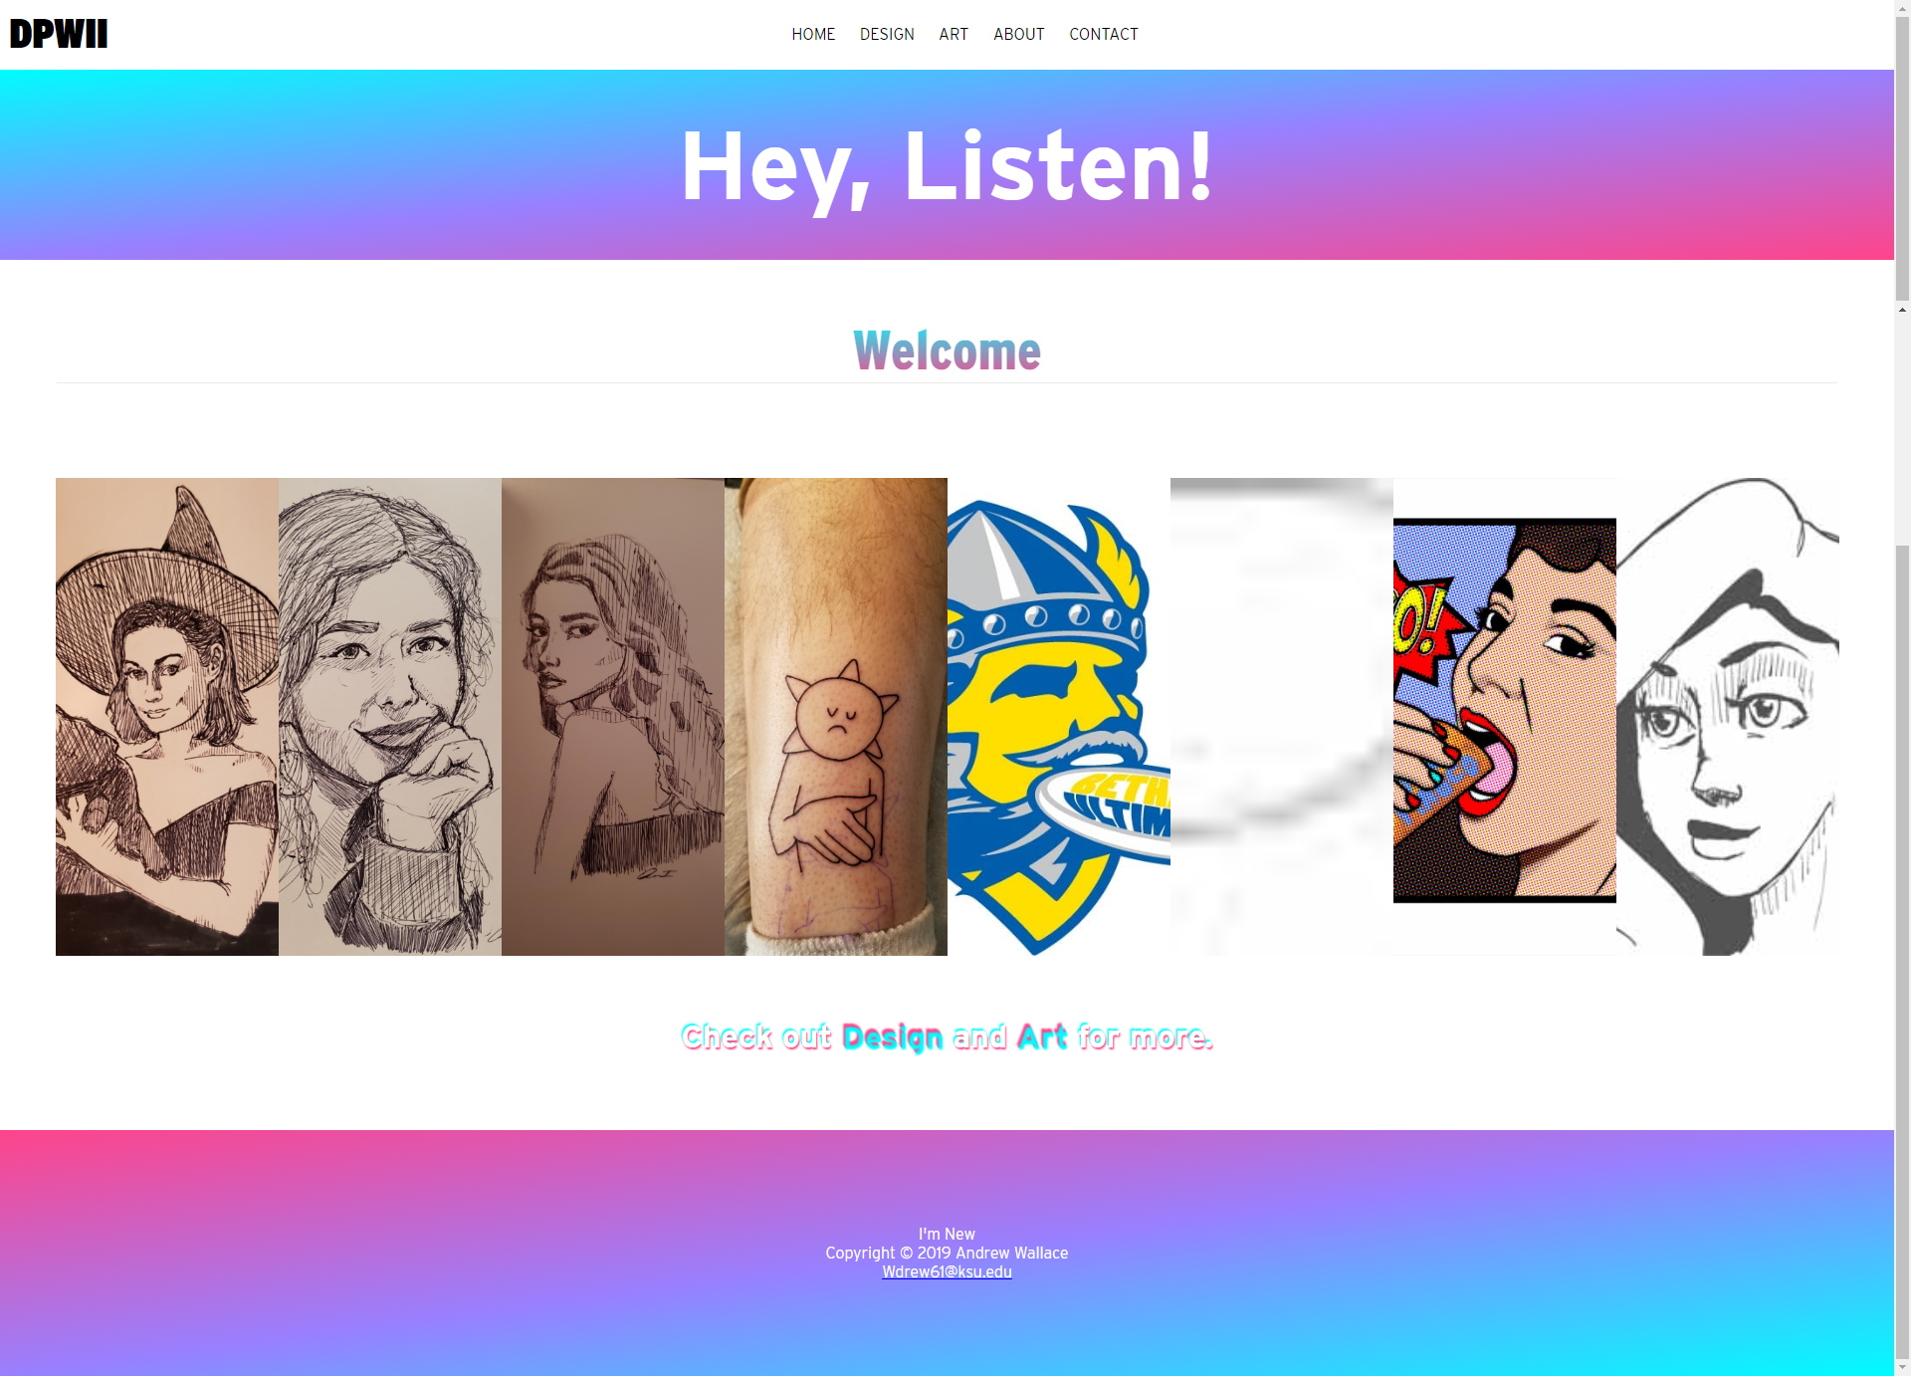
Index.html (home page)
Desktop
Mobile

Slide 3
Home page Purpose
To introduce the websites design language (bright, attention-grabbing gradients with a modern, contemporary feel.) which is simple and effective.
To display a small sample of work via a flexbox gallery to entice newcomers to venture deeper into my website and view my other works.
To provide easy and convenient means of navigation throughout the site.
To be responsive and scalable between mobile and desktop while still maintaining good elements of design and following the site’s aesthetic.

Slide 4
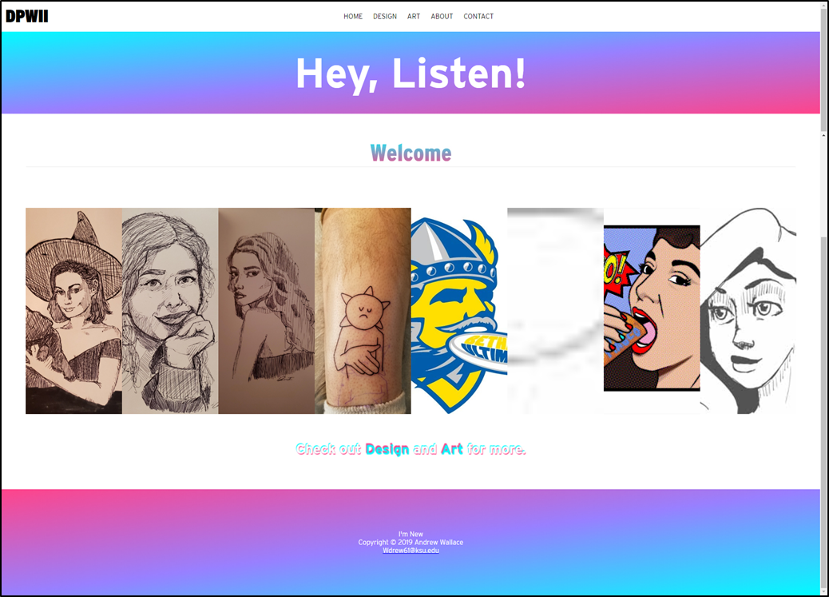
DESKTOP
Consistent & stylish logo
Easy and intuitive navigation menu
Vivid gradient banners w/ greeting on main banner typical of modern websites
Example of work that is to be shown on site providing promotion to the “DESIGN” and “ART” pages
Styled hyperlinks to promote travel to other pages within site
Non-intrusive yet effective footer providing copyright info

Slide 5
MOBILE
Hamburger Menu for responsiveness
Full page scale down made with @media tags to providing mobile usability and ease of access
Flexbox “sample” gallery and “design” and “art” page links to advertise to mobile users what the website is about, to be a portfolio

Slide 6
Design Page Purpose
Convey the idea that my work is more than just art
Provide an interactive gallery for users to sort through design specifics works
Display my abilities in coding and programming by displaying my program “Cursor Cruiser” underneath gallery
Advertise and Link to other pages within website, namely “ART” to show visitors other less design and professional oriented work to display ability.

Slide 7
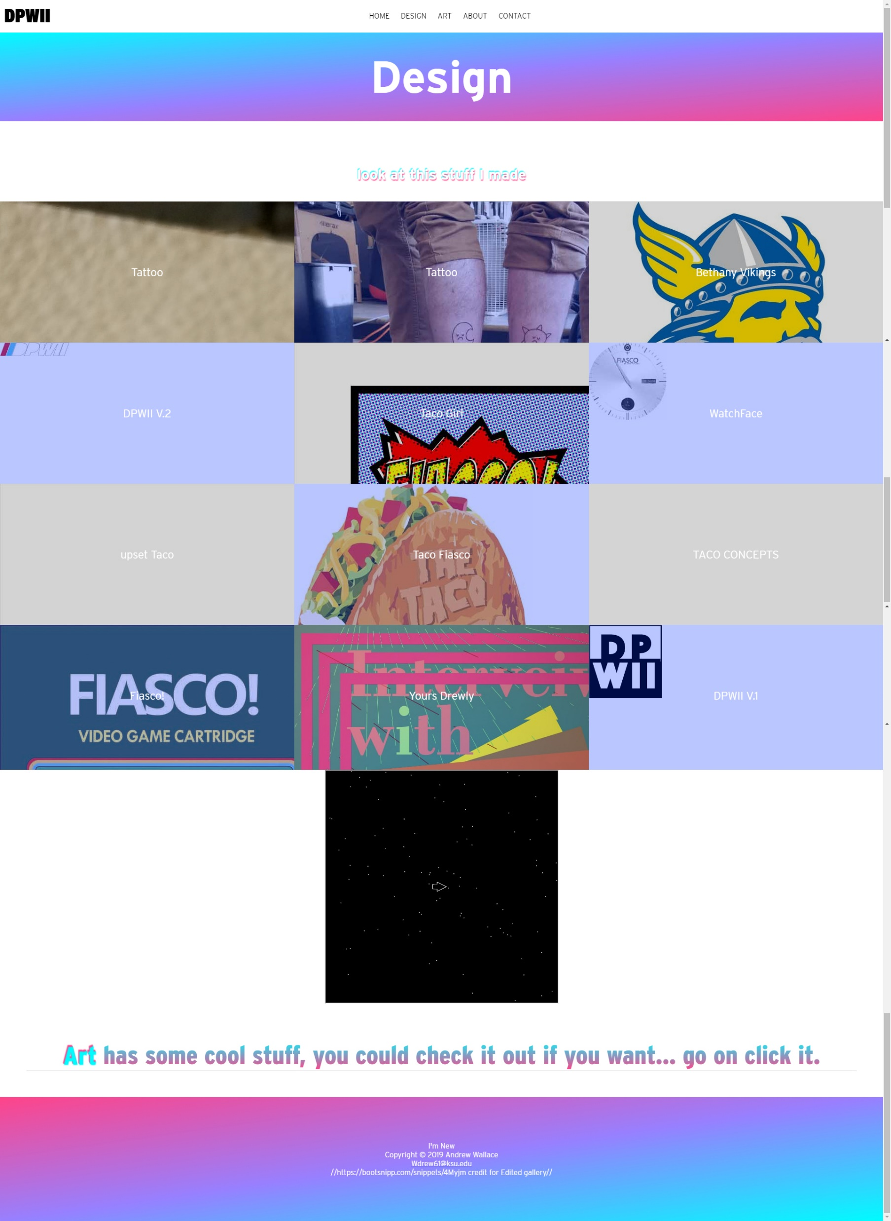
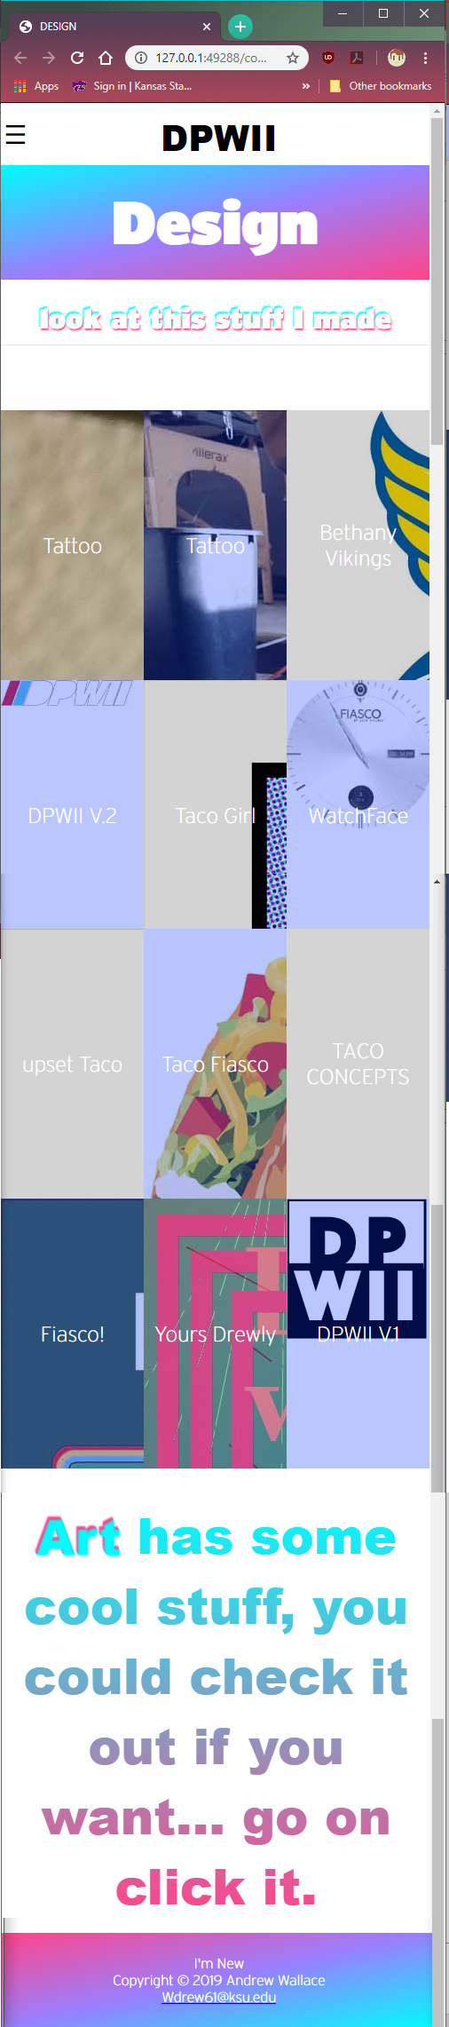
Design Page
Desktop
Mobile
Banner stating what page visitors are on
Bootstrap Design gallery with thumbnails, links to full size images, and modern style hover with slight image zoom
Gallery has been sized down to provide responsiveness to mobile
Site page scales for mobile users
Script is taken from page as mobile user could not interact with the programming
Stylish hyperlink and text gradient to stay consistent with aesthetic and to advertise art page
Script displaying Computing principles final project “Cursor Cruiser” game which can be operated using arrow keys, demonstrating my programming ability

Slide 8
Art Page Purpose
Convey the idea that my work is more than just design work
Provide an interactive gallery for users to sort through art centric work
Display my abilities in animation by displaying my most recent animation above a gallery of my most recent work.
Advertise and Link to other pages within website, namely “Design” to show visitors other more professional and applicable work to display ability.
Provide accessibility to mobile users as well.

Slide 9
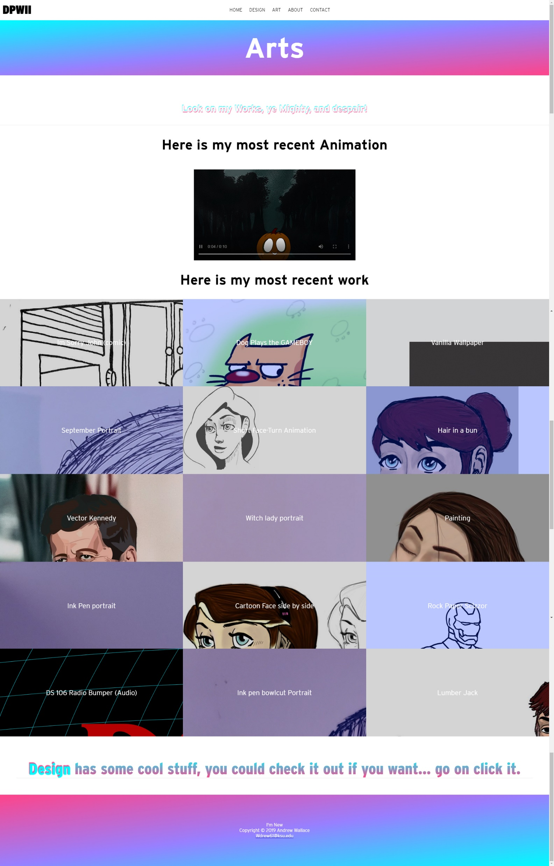
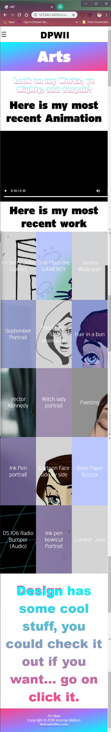
Art Page
Iframe element displaying most recent animation video
Bootstrap gallery displaying most recent artwork with interactive hover feature and links to fullsized artwork
Page scales accordingly and is responsive for mobile users and provides everything provided on desktop
Nonchalant advertisement and link to design page
Desktop
Mobile

Slide 10
About Page Purpose
Give the visitor the ability to learn some background as to who I am and why I made this page
Answer questions of academic majors and field of study.
Provide opportunity for visitors to visit other sites to with which my work is displayed.
Provide visitors other ways to communicate with me.
Advertise and Link to other pages like LinkedIn for career purposes.
Provide accessibility to mobile users as well.

Slide 11
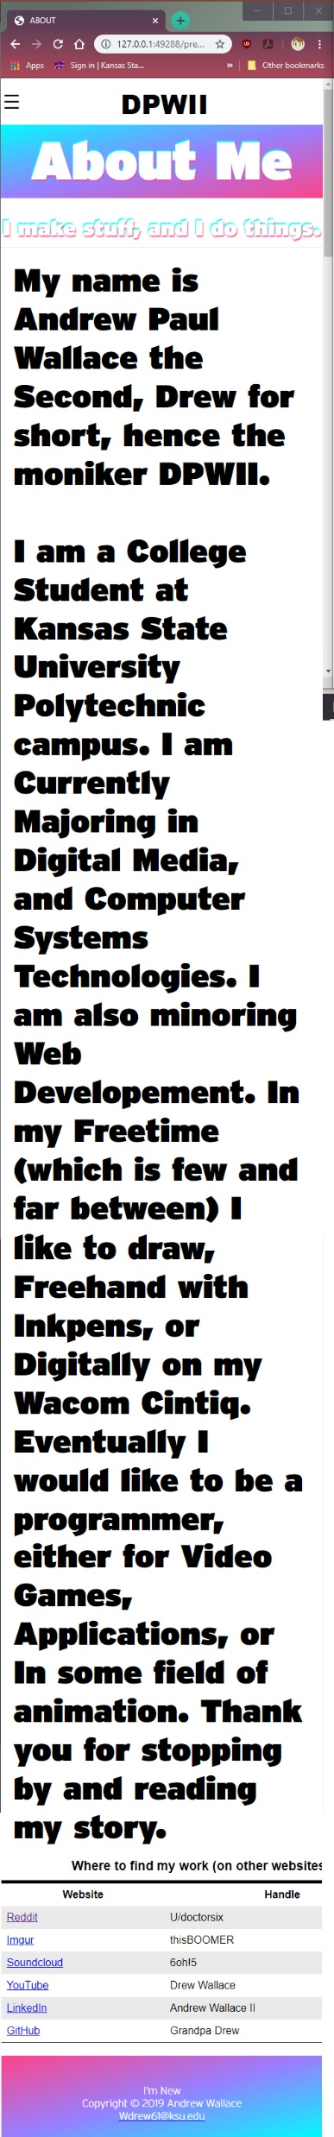
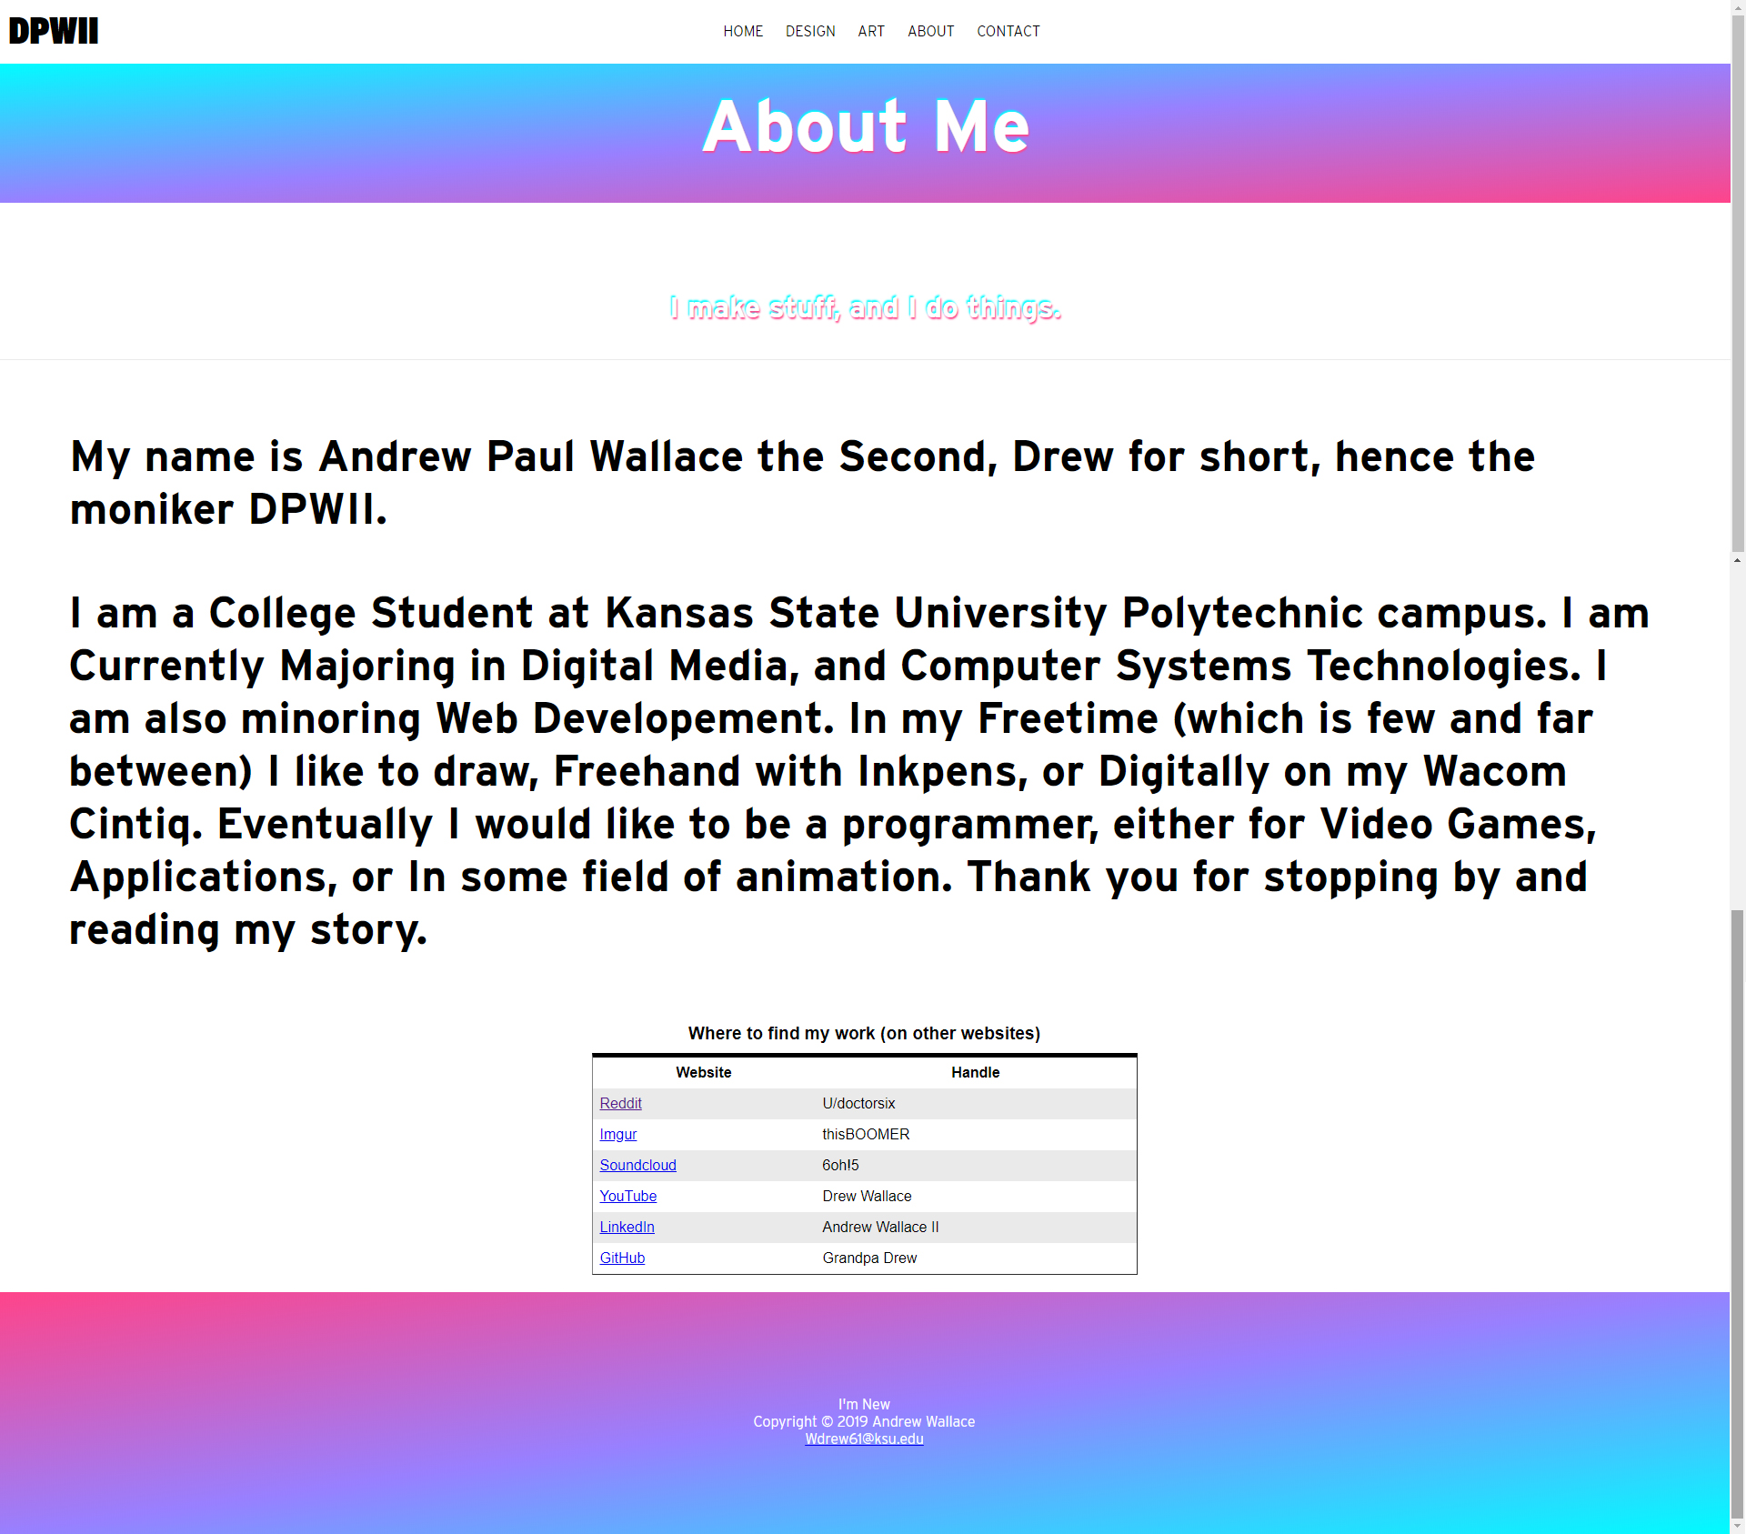
About page
Description of Webpage title and logo
Description of fields of study and why am displaying the type of portfolio I display on “DESIGN” tab and “ART” tab
Table of usernames and websites I can be found to communicate and operate on.
Desktop
Mobile

Slide 12
Contact page Purpose
Give the visitor the ability to communicate with me directly
Provide an easy and responsive “get” form to fill out.
Provide visitors a singular comprehensive, on-site way of communicating with me.
To complete website to and make website modernized and accessible.

Slide 13
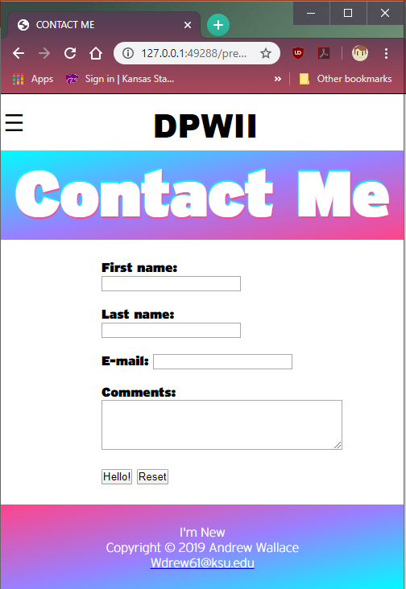
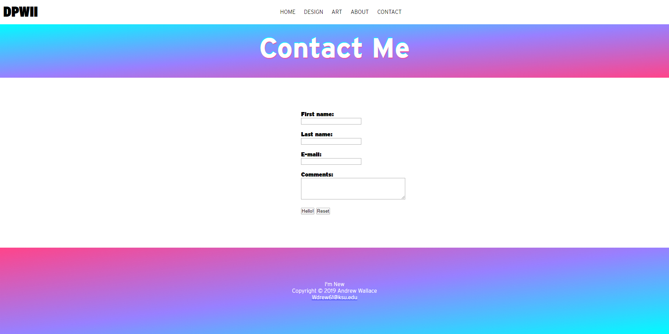
Contact Page
Page banner alerting visitor of what page they are on.
Easy, Stylish and intuitive “get” form for users to fill out to contact me without leaving the site
Desktop
Mobile

Slide 14
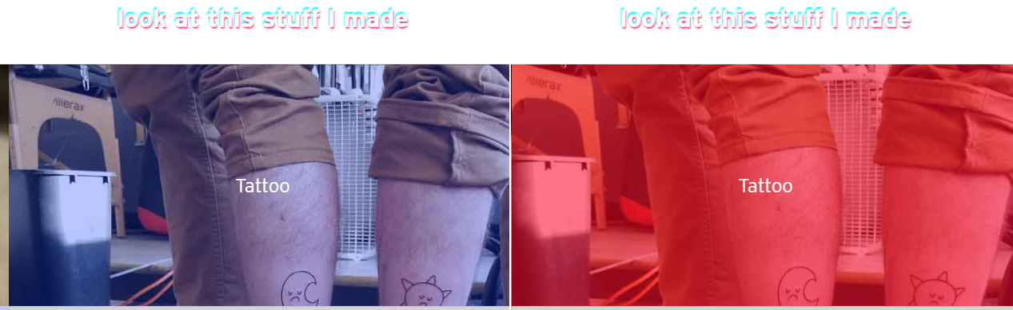
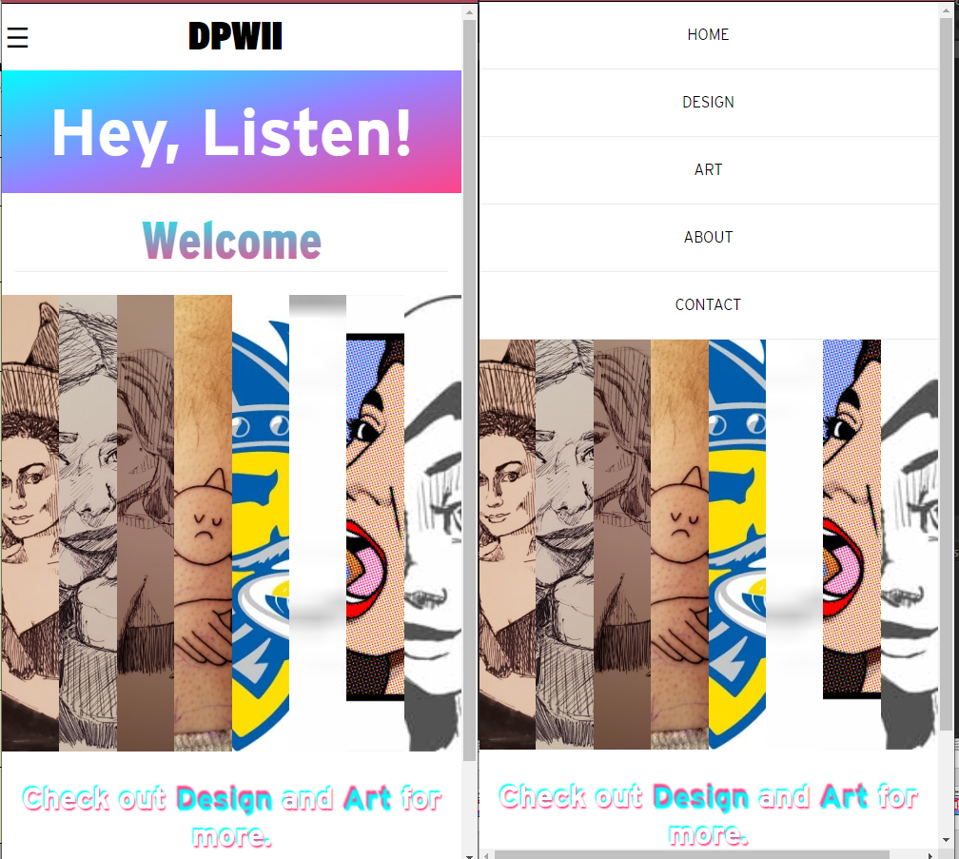
Features
BEFORE AFTER
HEADER/NAV BAR animated fade in on display and refresh
BEFORE AFTER
Gallery color change/zoom animation on hover
BEFORE AFTER
Fold down hamburger menu on toggle of menu button top left.

Slide 15
Design
Consistent, responsive and Aesthetically pleasing Gradients on Banner and footer
Text gradients to match aesthetic
Responsive galleries, navigation and logo
Bold, serif logo top left corner contrasts main page design but still fits aesthetic.

Slide 16
Experience Gained/Difficulties
Difficulties with flex box alignment and construction, provided reason to do extensive research on how to properly implement flexboxes
Gained experience with bootstrap and construction of galleries as well as how to make them aesthetically pleasing and modern
Gained experience in Grid elements, alignments, construction and how to properly execute rows and columns to align items such as logos, scripts and iframe elements to be in certain positions on page and to be responsive.
Gained extensive experience in responsiveness and how to construct webpages from start to finish and give sites the ability to work on desktop and mobile.

Slide 17
Summary
My website is detail-oriented, organized, and design focused while displaying everything I wanted to display in a portfolio. Going forward it will be easier to accomplish webpage composition as I have learned a significant amount working on this website from start to finish. Although originally a daunting task and some of the design elements may be a bit tacky, I firmly believe that this is my style and that every bit of this website is tailored to how I want to present my work on a webpage I created, I do wish I had more scripts and programming associated with this page but that is sure to come in the future.

